Slide 1
Mental-2024 Proposed model_Misclassification
모바일시스템공학과
이승재

Slide 2
1. Misclassification distribution
Misclassification 1
Misclassification 2
Misclassification 3
Misclassification 7
. . .
Common Misclassification

Slide 3
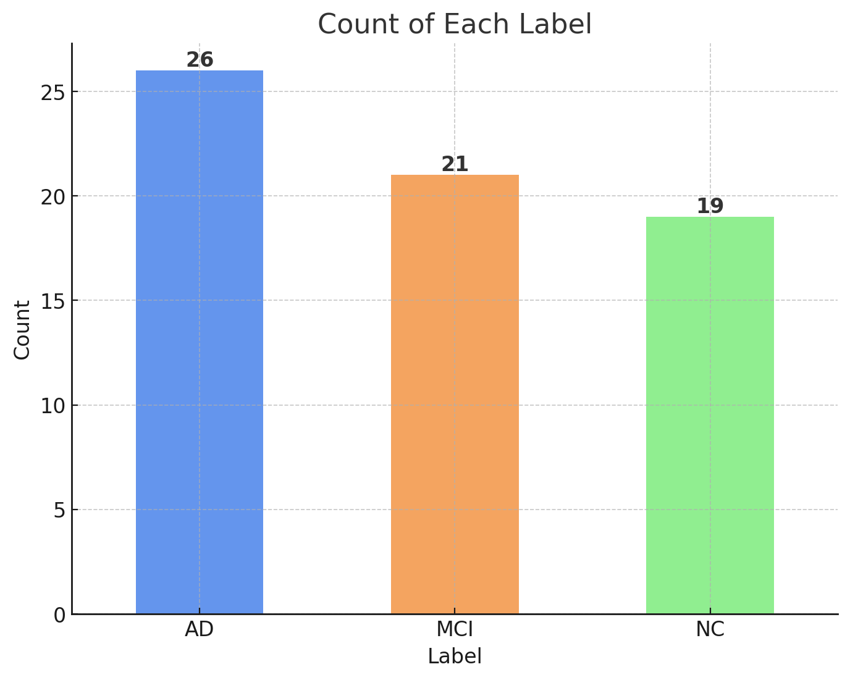

1. Misclassification distribution

Slide 4
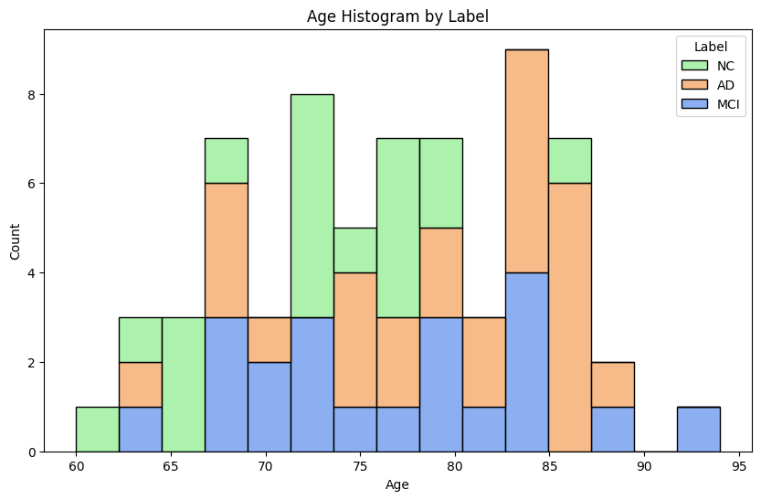
1. Misclassification distribution

Slide 5

2. Reasons for misclassification
“If we assume that the cause of misclassification is in the prompt, I think there are two causes.”
Mistranslation
Differences in degree of translation
Mistranslation of technical terms
Missing content
Omission regarding <가족 관계>
Omission of +, - signs
Omission of content that does not belong in the category

Slide 6
3. Mistranslation
<지남력> 연월일요일 : DK/DK/DK/DK/가을 (-,-,-,-,+)
Low specificity
Translation : “Does not remember dates or days, partially knows the season.”
기타 ; 풍-뇌경변(2003년12/23) 팔은 괜찮으나 손 마비, 다리 한쪽 잘 못 걸음(둘다왼쪽)
Mistranslation of technical terms
Translation : “Stroke-cerebral arteriosclerosis (2003/12/23), arm is fine but hand is numb, difficulty walking with one leg (both left).”
<판단 및 문제해결>
이해력 저하(-) 사회적 판단력(-) 예의범절 (-)
The translation is too condensed
Translation : “No breaches in manners.”

Slide 7
4. Missing content
“Consecutive + and - signs were not recognized and translations were sometimes missing.”
<성격, 행동> 없음(-),일 이상 또는 하루 중 절반이상(+), 거의매일 그리고 하루중 대부분(++)
우울(-) 흥미소실(-), 식욕저하(+)또는 체중변화(-): 5%/개월 이상, 수면장애(++): 불면 지체 또는 초조(-), 피로 또는 기력 저하(-), 무가치감 또는 죄책감(-), 집중력저하 또는 결단력 저하 (++), 자살사고 또는 시도(-)
<성격, 행동>
우울(+) 흥미소실(+): 우울하고 재미있는 것이 없다고 함, 식욕저하(-), 체중변화(-),
수면장애(+): 수면제 없으면 못 주무신다고 함/ 지체초조(+): 배우자 때문에 그렇다고 함
피로감(-), 무 가치 감 또는 죄책감(-), 집중력저하(-),
자살사고(+): 전에 자살 충동을 느끼나, 지금은 그런 적이 없다고 함

Slide 8
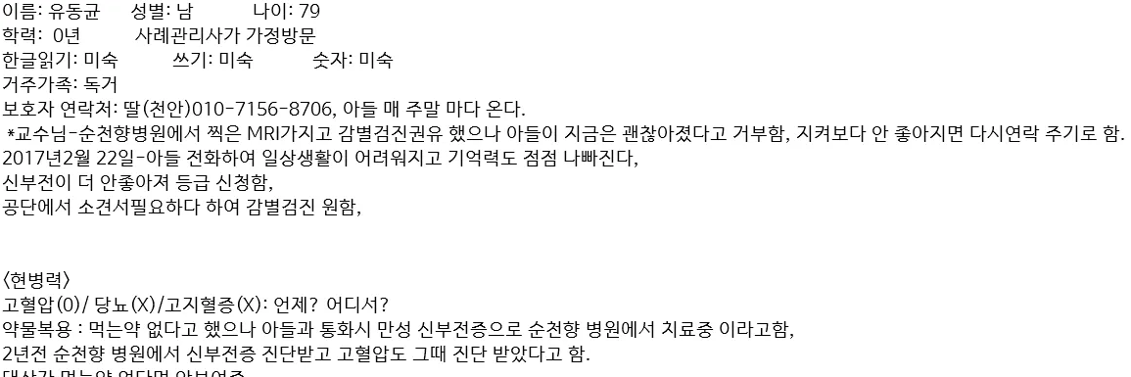
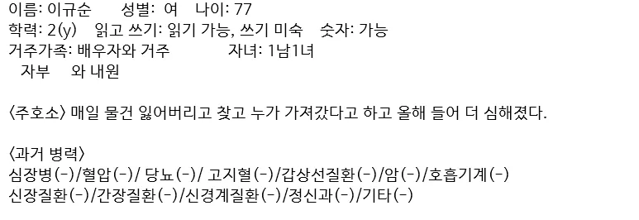
4. Missing content
“Translations are missing for content not included in the category.”
“Omission regarding <가족 관계>”

Slide 9
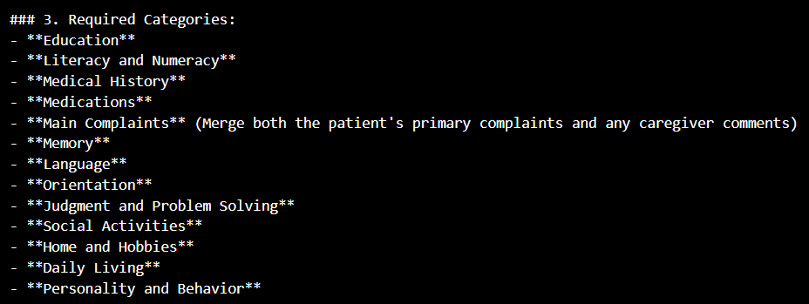


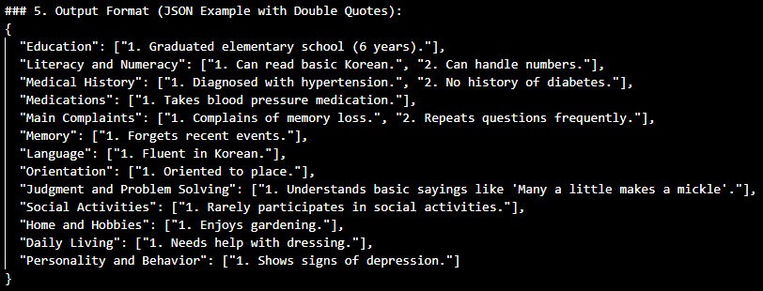
4. Missing content
**Family and Living Situation** (Include all details about family, caregivers, and living conditions)
+
**Additional Information** (Any relevant details not fitting into the categories above)
"Additional Information": ["1. Experienced emotional shock from losing two sons, received brief treatment at Dan Hospital (Neurology).", "2. Tremors in hands even while resting."],
+

Slide 10
4. Missing content
**Additional Information** (Any relevant details not fitting into the categories above)
?
“In the "Additional Information" category, it seems like it will be a part that needs to be experimented with to see if it will help or confuse the model's learning.”
"Additional Information": ["1. Experienced emotional shock from losing two sons, received brief treatment at Dan Hospital (Neurology).", "2. Tremors in hands even while resting."],

